Slide 1
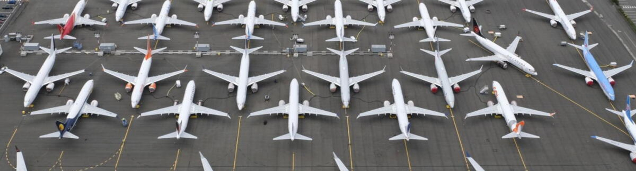
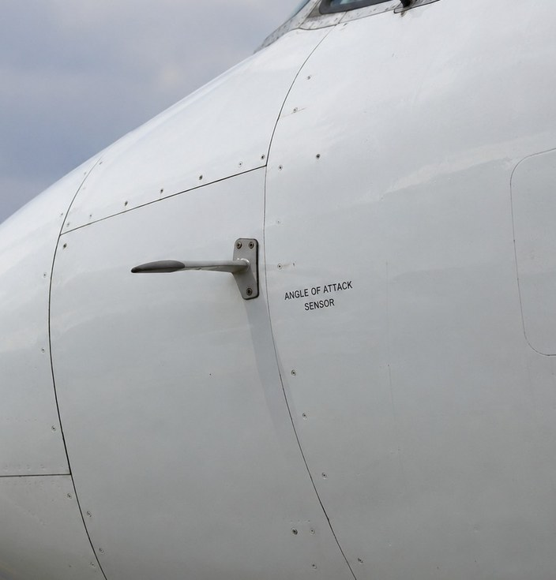
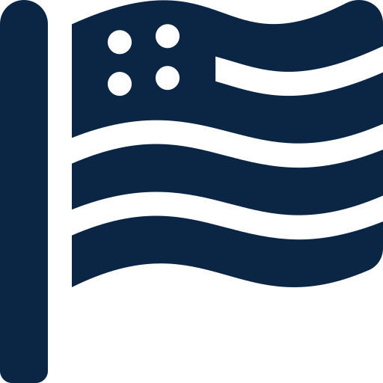





A US STORY · BOEING & THE FAA · 2018–2020
Boeing 737 MAX
346
Bug or Business Decision?
lives lost
[Your Name] · 4th Year Software Development Student, SETU · October 2026
1
What happened?
2
The hidden software: MCAS
Two new Boeing 737 MAX jets crashed minutes after take-off, less than five months apart.
Bigger engines, mounted further forward, made the MAX’s nose pitch up. Boeing added software, MCAS, to push it back down automatically, so the MAX handled like the old 737 and pilots wouldn’t need simulator training.
29 Oct 2018
Lion Air 610, Indonesia: 189 killed [4]
10 Mar 2019
Ethiopian Airlines 302: 157 killed [4]
13 Mar 2019
The FAA grounds the 737 MAX in the US [4]
Fig.1 An angle-of-attack (AoA) sensor. MCAS trusted just one.
18 Nov 2020
Cleared to fly again after a software fix [4]
// Simplified illustration
if (aoa > LIMIT && flapsUp)
trimNoseDown(2.5); // degrees
// ...repeats after pilot trims
// 2nd AoA sensor: never checked
Jan 2021
Boeing pays $2.5bn to settle a US fraud charge [5]
An American story: Boeing and its regulator, the FAA, are both US-based.
Fig.2 How MCAS behaved (simplified, not Boeing’s code)
3
Bug or business decision?
4
What should developers learn?
One sensor, no cross-check
“A horrific culmination of a series of faulty technical assumptions by Boeing’s engineers, a lack of transparency on the part of Boeing’s management, and grossly insufficient oversight by the FAA.”
US House Transportation Committee, 2020 [1]
A single point of failure in a system that could push the nose down. [2]
The limit grew over 4×
The FAA saw 0.6° in the safety analysis. The final design used 2.5°. [2]
Pilots weren’t told
Fig.3 The limit the FAA saw vs. what flew [2]
Fig.4 Families holding photos of Ethiopian 302 victims
MCAS wasn’t disclosed to pilots, and the ‘AoA disagree’ alert only worked with an optional extra. [3][4]
Not a bug: the code did exactly what it was designed to do.
Ask yourself:
Would you ship a safety feature that trusts one sensor?
When the requirement changes, does the safety analysis?
If users don’t know your code exists, how can they fight it?
Training was a cost
Boeing promised Southwest $1M per plane if its pilots needed simulator training. [1]
References
[1] US House Committee on Transportation and Infrastructure (2020) Final Committee Report: The Design, Development & Certification of the Boeing 737 MAX. September 2020.
[2] Gates, D. (2019) Flawed analysis, failed oversight: How Boeing, FAA certified the suspect 737 MAX flight control system. The Seattle Times, 17 March 2019.
[3] CNBC (2018) Optional warning light could have aided Lion Air before crash. CNBC, 30 November 2018.
[4] Associated Press (2025) Timeline: Key events in the troubled history of the Boeing 737 Max jetliner. AP, September 2025.
[5] Reuters (2021) Boeing pays $2.5bn to settle US fraud charge over 737 MAX. Published via BusinessLIVE, 8 January 2021.
Photos: [add the source of each photo]. Icons: Font Awesome Free (CC BY 4.0).

